Slide 1
RAG system improvements & evaluation

Slide 2
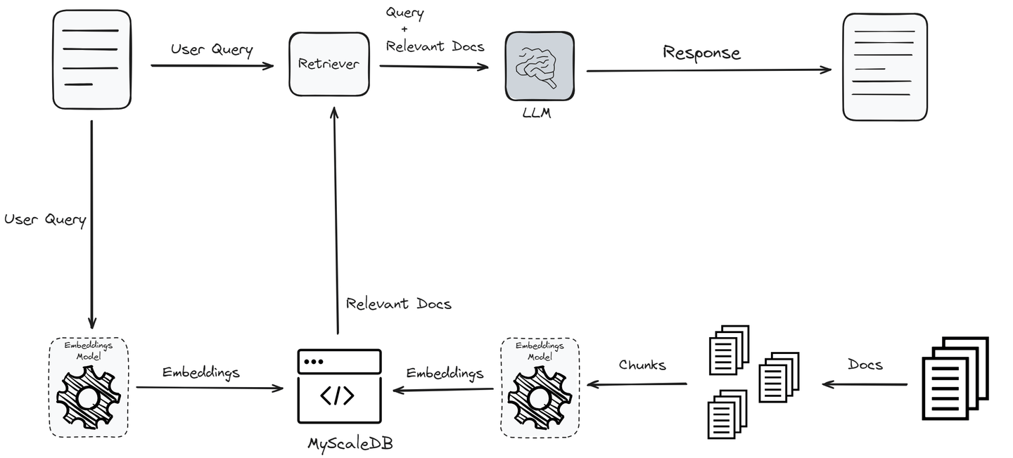
RAG 101
Motivation: Base LLM lacks internal knowledge
RAG: concept to provide LLMs with additional information from an external knowledge source. This allows them to generate more accurate and contextual answers while reducing hallucinations.
4 steps:
Create: documents are stored into vector database
Retrieve: The user query is used to retrieve relevant context from an external knowledge source. For this, the user query is embedded with an embedding model into the same vector space as the additional context in the vector database. This allows to perform a similarity search, and the top k closest data objects from the vector database are returned.
Augment: The user query and the retrieved additional context are stuffed into a prompt template.
Generate: Finally, the retrieval-augmented prompt is fed to the LLM.

Slide 3
RAG Evaluation Framework
TRIAD framework:
RAGAS package: https://docs.ragas.io/en/stable/
DeepEval package: https://docs.confident-ai.com/docs/getting-started
TruEval package: https://github.com/truera/trulens
Using LLM as a judge
https://huggingface.co/learn/cookbook/en/rag_evaluation
RAG system evaluation is 3-folds:
Chunking Evaluation
Retrieval Evaluation
Overall Response Evaluation

Slide 4
RAG evaluation framework (1/2)
https://www.pinecone.io/learn/series/vector-databases-in-production-for-busy-engineers/rag-evaluation/#Determining-which-RAG-evaluation-framework-is-right-for-you
Use Case | Recommended Framework | Metrics Used | Reasoning
Initial RAG evaluations | RAGAS | Average Precision (AP), Faithfulness | RAGAS is ideal for initial evaluations, especially in environments where reference data is scarce. It focuses on precision and how faithfully the response matches the provided context.
Dynamic, continuous RAG deployments | ARES | MRR, NDCG | ARES uses synthetic data and LLM judges, which are suitable for environments needing continuous updates and training and focusing on response ranking and relevance.
Full system traces including LLMs and Vector storage | TraceLoop | Information Gain, Factual Consistency, Citation Accuracy | TraceLoop is best suited for applications where tracing the flow and provenance of information used in the generated output is critical, such as academic research or journalism.
Real-time RAG monitoring | Arize | Precision, Recall, F1 | Arize excels in real-time performance monitoring, making it perfect for deployments where immediate feedback on RAG performance is essential
Enterprise-level RAG applications | Galileo | Custom metrics, Context Adherence | Galileo provides advanced insights and metrics integration for complex applications, ensuring RAG’s adherence to context.
Optimizing RAG for specific domains | TruLens | Domain-specific accuracy, Precision | TruLens is designed to optimize RAG systems within specific domains, by enhancing the accuracy and precision of domain-relevant responses

Slide 5
RAG evaluation framework (2/2)
https://www.pinecone.io/learn/series/vector-databases-in-production-for-busy-engineers/rag-evaluation/#Determining-which-RAG-evaluation-framework-is-right-for-you
Arize: Arize acts as a model monitoring platform and adapts well to evaluating RAG systems by focusing on Precision, Recall, and F1 Score. It is beneficial in scenarios requiring ongoing performance tracking, ensuring RAG systems consistently meet accuracy thresholds in real-time applications. Arize is a proprietary paid offering providing robust support and continuous updates for enterprise deployments.
ARES: ARES leverages synthetic data and LLM judges, emphasizing Mean Reciprocal Rank (MRR) and Normalized Discounted Cumulative Gain (NDCG). It is ideal for dynamic environments where continuous training and updates are necessary to maintain system relevance and accuracy. ARES is an open-source framework that provides data sets to facilitate getting started.
RAGAS: RAGAS offers streamlined, reference-free evaluation focusing on Average Precision (AP) and custom metrics like Faithfulness. It assesses how well the content generated aligns with provided contexts and is suitable for initial assessments or when reference data is scarce. RAGAS is an open-source tool, allowing for flexible adaptation and integration into diverse RAG systems without the financial overhead of licensed software.
TraceLoop: TraceLoop is an open-source RAG evaluation framework that focuses on tracing the origins and flow of information throughout the retrieval and generation process.
TruLens: TruLens specializes in domain-specific optimizations for RAG systems, emphasizing accuracy and precision tailored to specific fields. It offers detailed metrics to assess retrieval components' domain relevance. TruLens is a proprietary tool for enterprises seeking specialized, high-performance RAG solutions with robust customer support and regular updates to align with evolving domain-specific needs.
Galileo: Galileo's RAG tool integrates advanced insights and metrics into users' workflows, focusing on enhancing the performance and transparency of RAG systems. It facilitates easy access to evaluation metrics and simplifies the management of large-scale RAG deployments. Galileo offers its solutions as a proprietary service, which is ideal for businesses seeking comprehensive, scalable AI tools emphasizing usability and commercial application integration.

Slide 6
Methodology
Create test dataset
Choose model parameters:
chunking methods
Embedding model
Choose metrics
Evaluate metrics

Slide 7
Initial step: internal documents embeddings
Chunking Method (from naïve to more advanced)
Fixed Sized Chunking
CharacterTextSplitting
SentenceTextSplitting
Recursive Chunking
Document Based Chunking
Token Based Chunking
Semantic Chunking
Agentic Chunking
Embedding Model

Slide 8
Chunking methods
Fixed Length: this is the most crude and simplest method of segmenting the text. It breaks down the text into chunks of a specified number of characters, regardless of their content or structure.
Recursive Chunking: advanced version that divides the text into chunks until a certain condition is met, such as reaching a minimum chunk size. This method ensures that the chunking process aligns with the text's structure, preserving more meaning. Its adaptability makes Recursive Character Chunking great for texts with varied structures.
Document splitting: strategy that respects the document's structure. Rather than using a set number of characters or a recursive process, it creates chunks that align with the logical sections of the document, like paragraphs or subsections. This approach maintains the original author's organization of content and helps keep the text coherent. It makes the retrieved information more relevant and useful, particularly for structured documents with clearly defined sections.
Tokens base: Language models used in the rest of your possible RAG pipeline have a token limit, which should not be exceeded.
Semantic based: method aims to extract semantic meaning from embeddings and then assess the semantic relationship between these chunks. The core idea is to keep together chunks that are semantic similar.
Agentic Chunking: uses Large Language Models to dynamically optimize text chunking based on context.

Slide 9
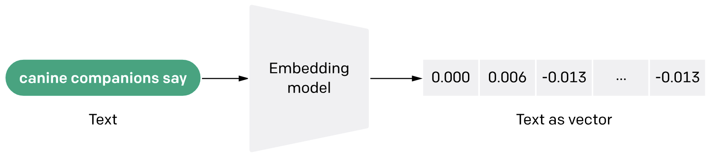
Embedding model
Retrieval Average: Represents average Normalized Discounted Cumulative Gain (NDCG) @ 10 across several datasets. NDCG is a common metric to measure the performance of retrieval systems. A higher NDCG indicates a model that is better at ranking relevant items higher in the list of retrieved results.
Model Size: Size of the model (in GB). It gives an idea of the computational resources required to run the model. While retrieval performance scales with model size, it is important to note that model size also has a direct impact on latency. The latency-performance trade-off becomes especially important in a production setup.
Max Tokens: Number of tokens that can be compressed into a single embedding. You typically don’t want to put more than a single paragraph of text (~100 tokens) into a single embedding. So even models with max tokens of 512 should be more than enough.
Embedding Dimensions: Length of the embedding vector. Smaller embeddings offer faster inference and are more storage-efficient, while more dimensions can capture nuanced details and relationships in the data. Ultimately, we want a good trade-off between capturing the complexity of data and operational efficiency.
Embedding = string encoding
Motivation: allow the efficient retrieval of relevant information.
When selecting an embedding model, consider the vector dimension, average retrieval performance, and model size.
Other consideration:
Cost
Search Latency
Language Support

Slide 10
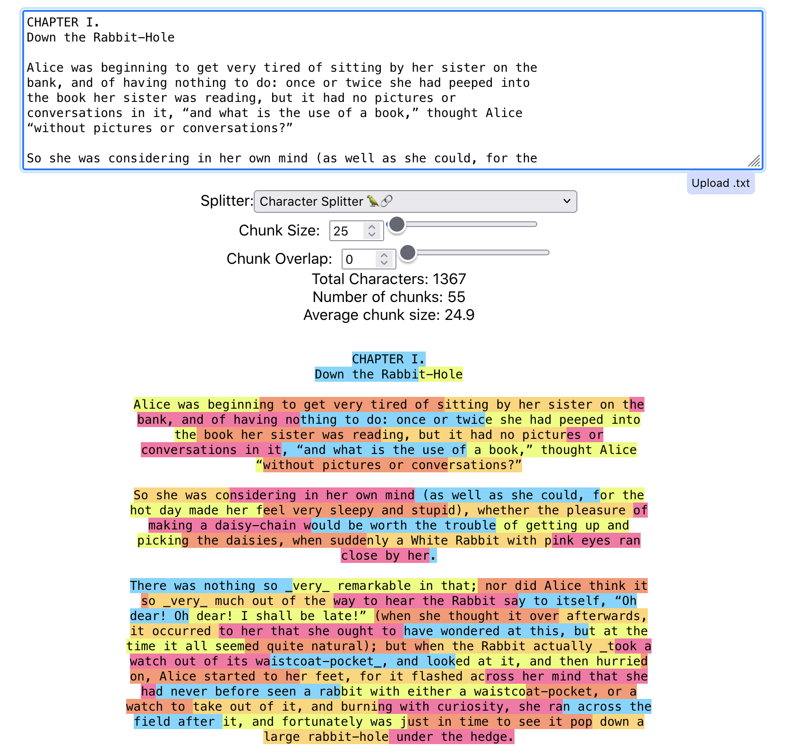
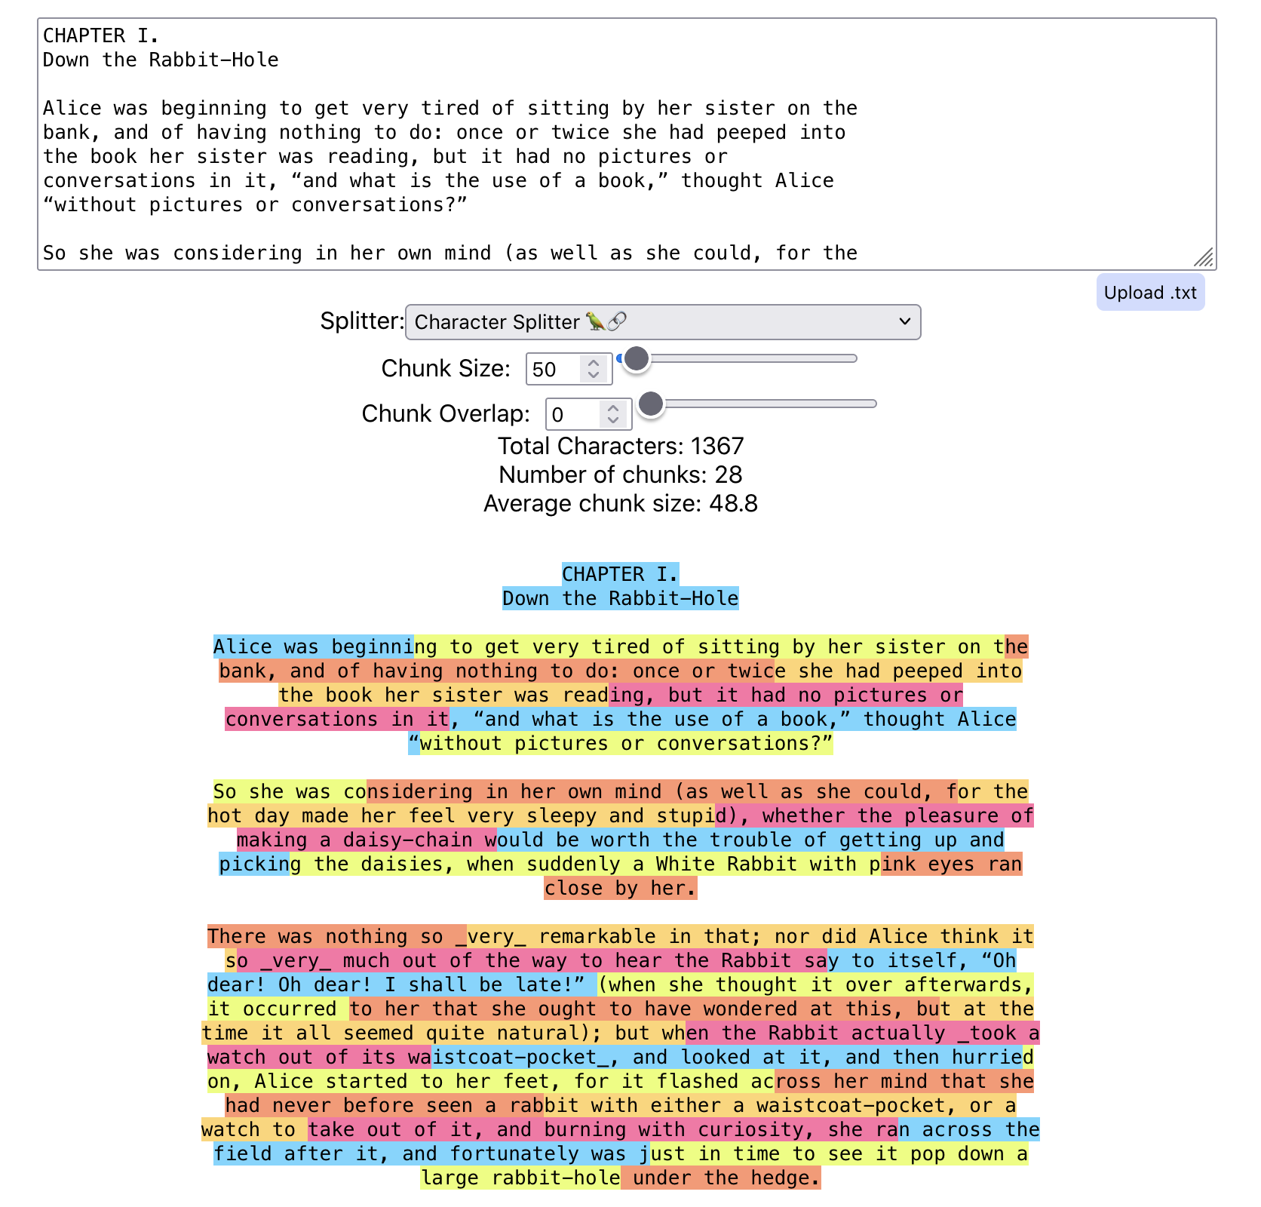
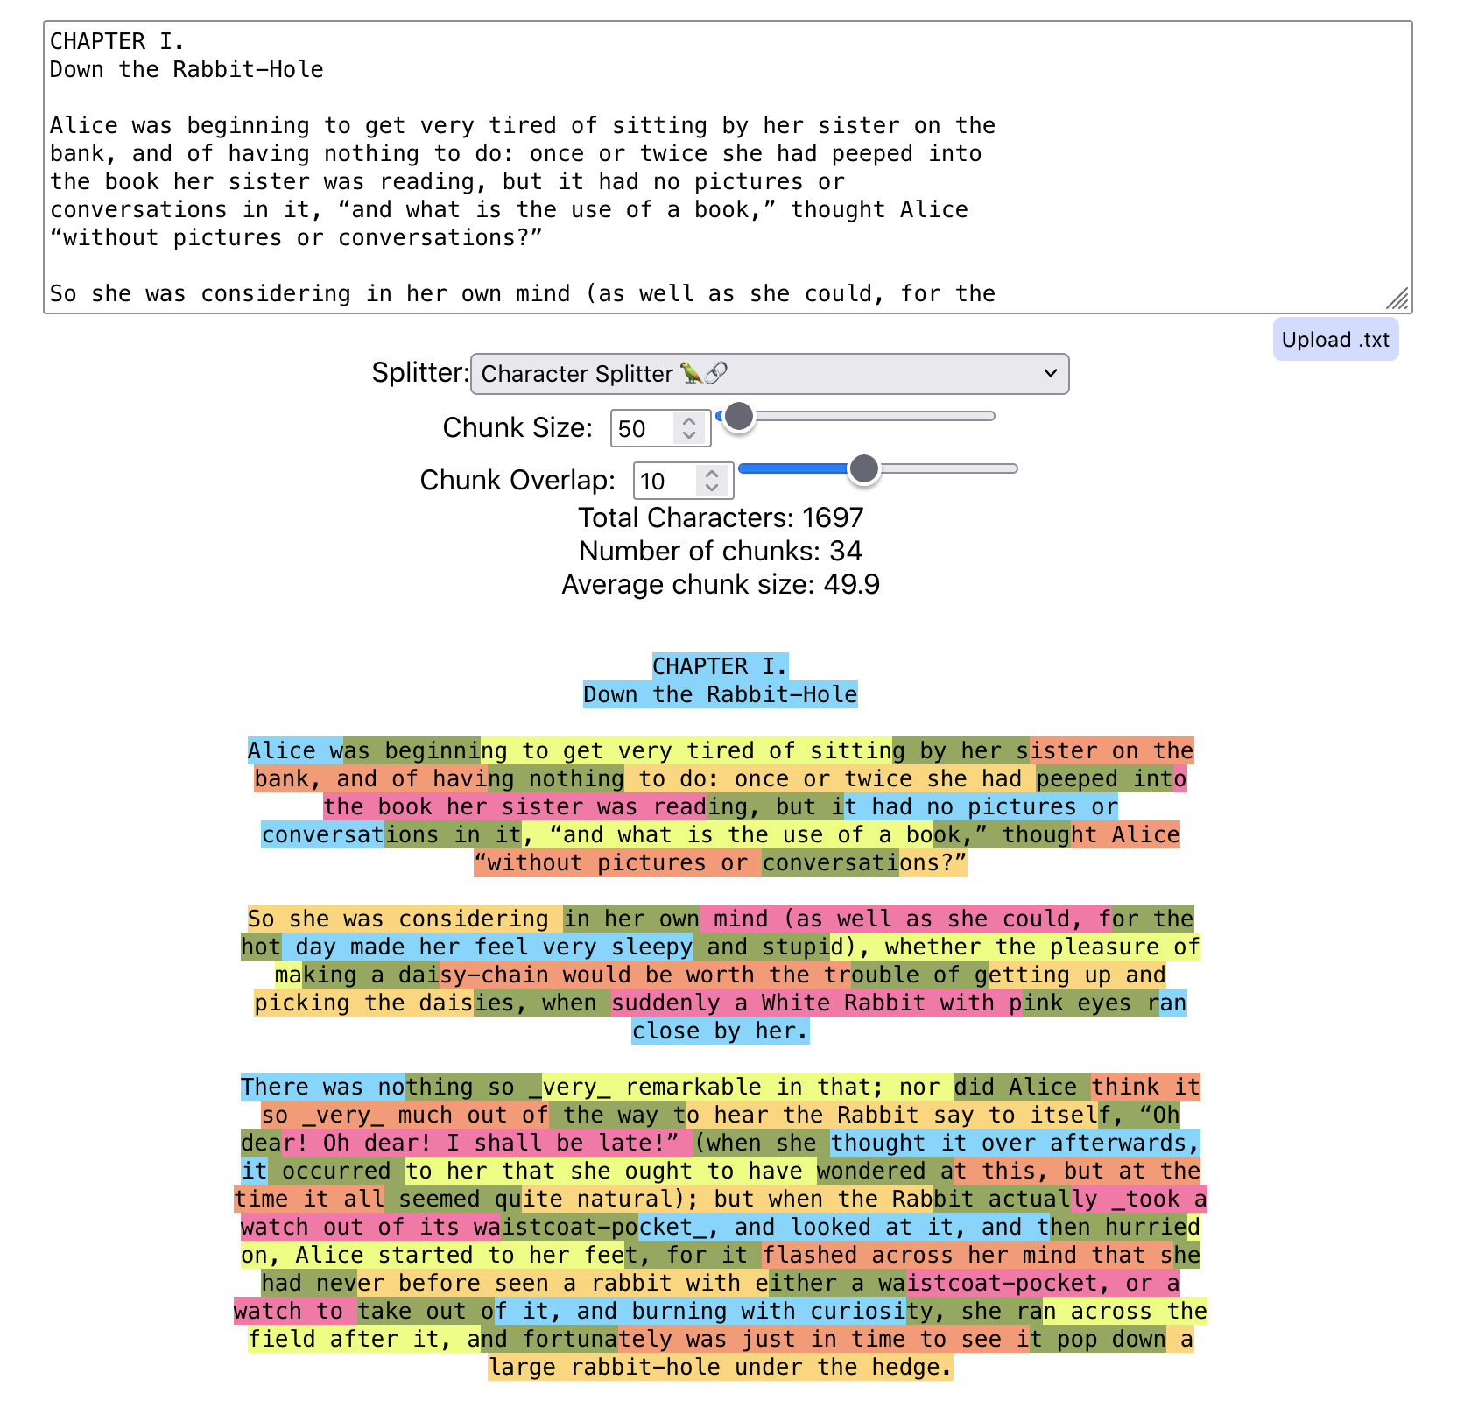
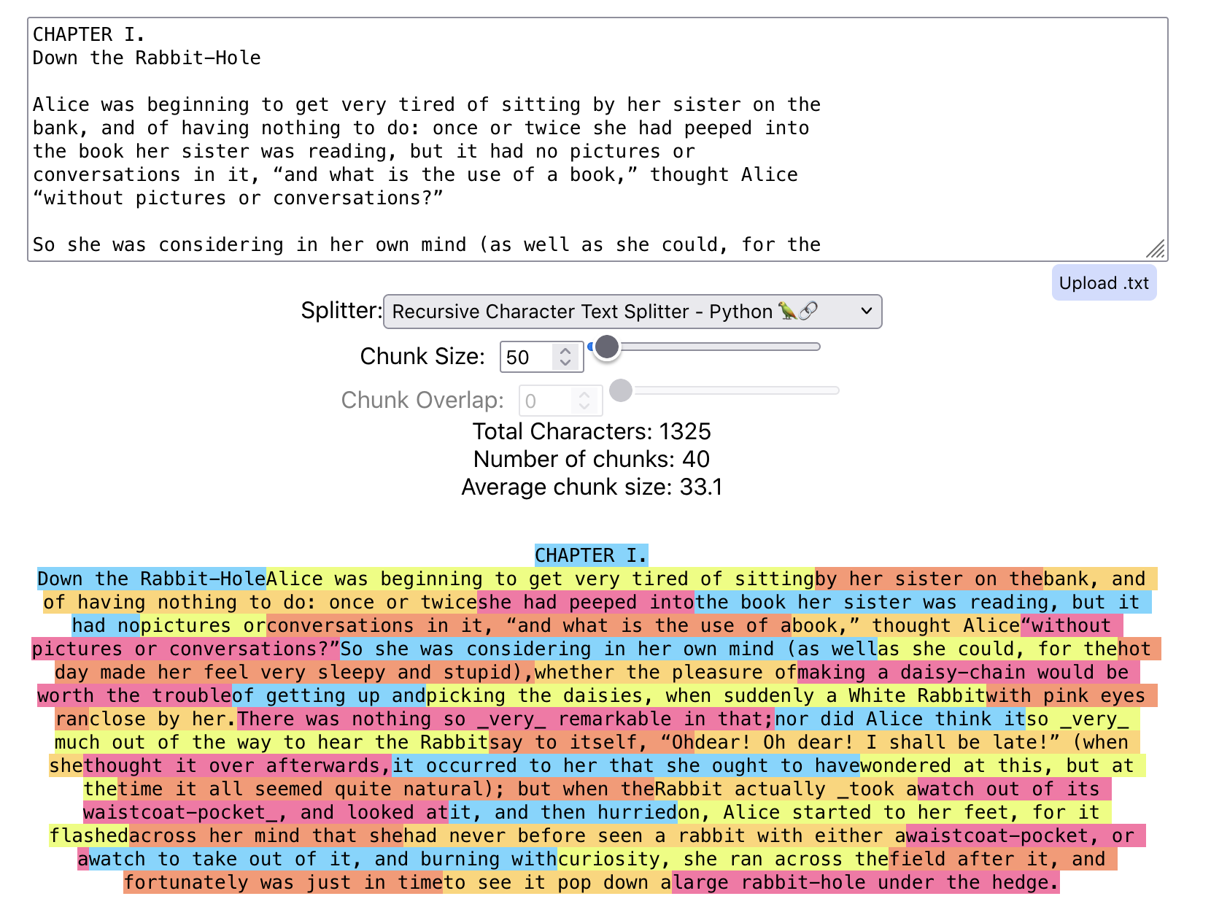
Examples
https://chunkviz.up.railway.app/

Slide 11
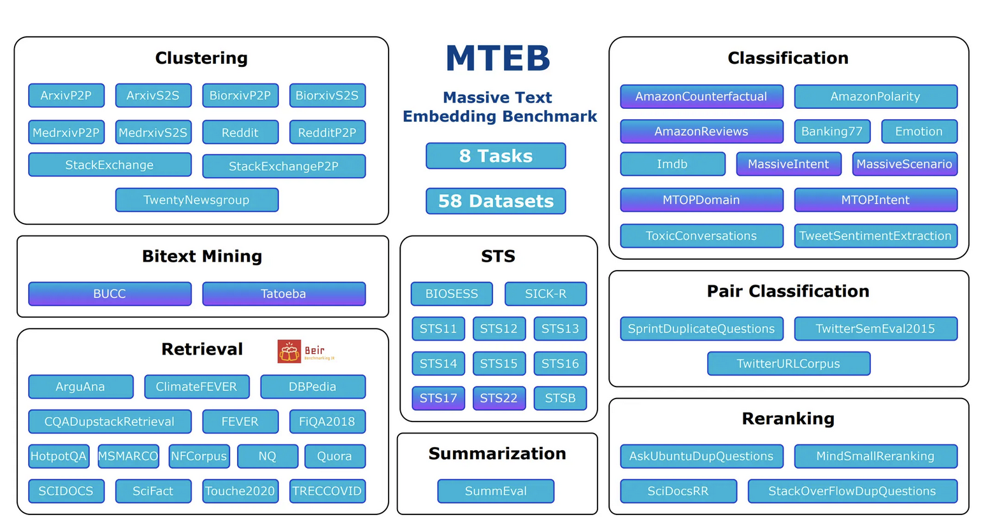
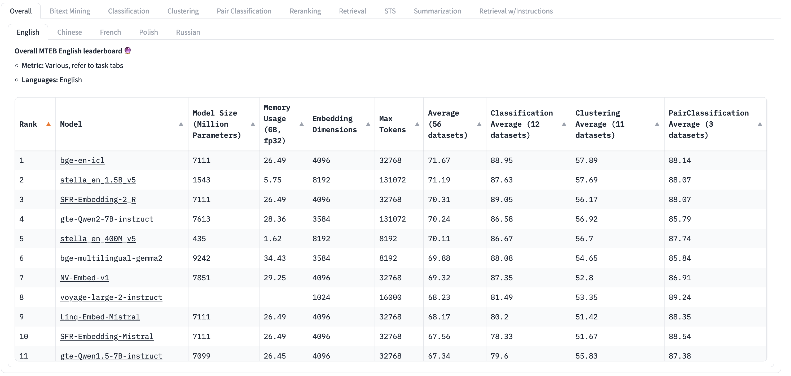
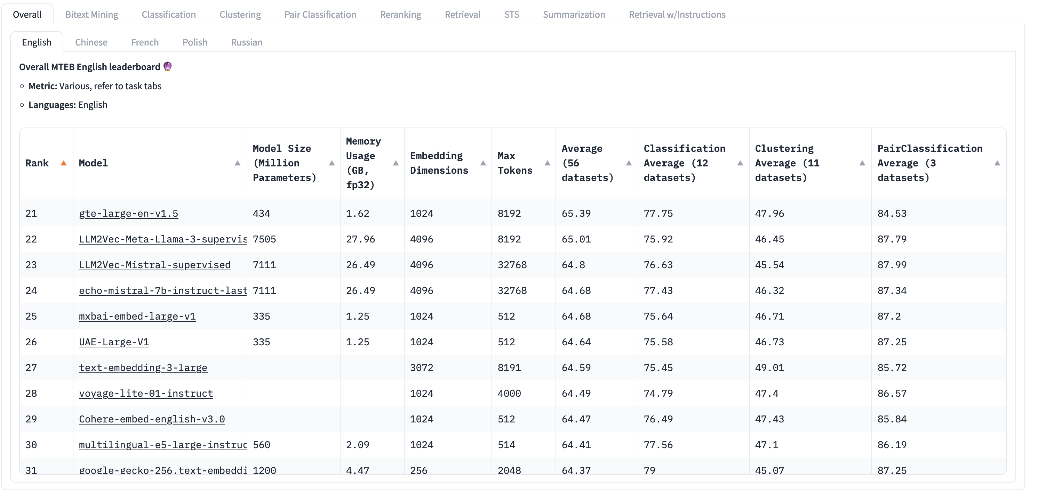
Embedding models Performances
Source: HugginFace
https://huggingface.co/spaces/mteb/leaderboard

Slide 12
Retrieval and Overall Response evaluation

Slide 13
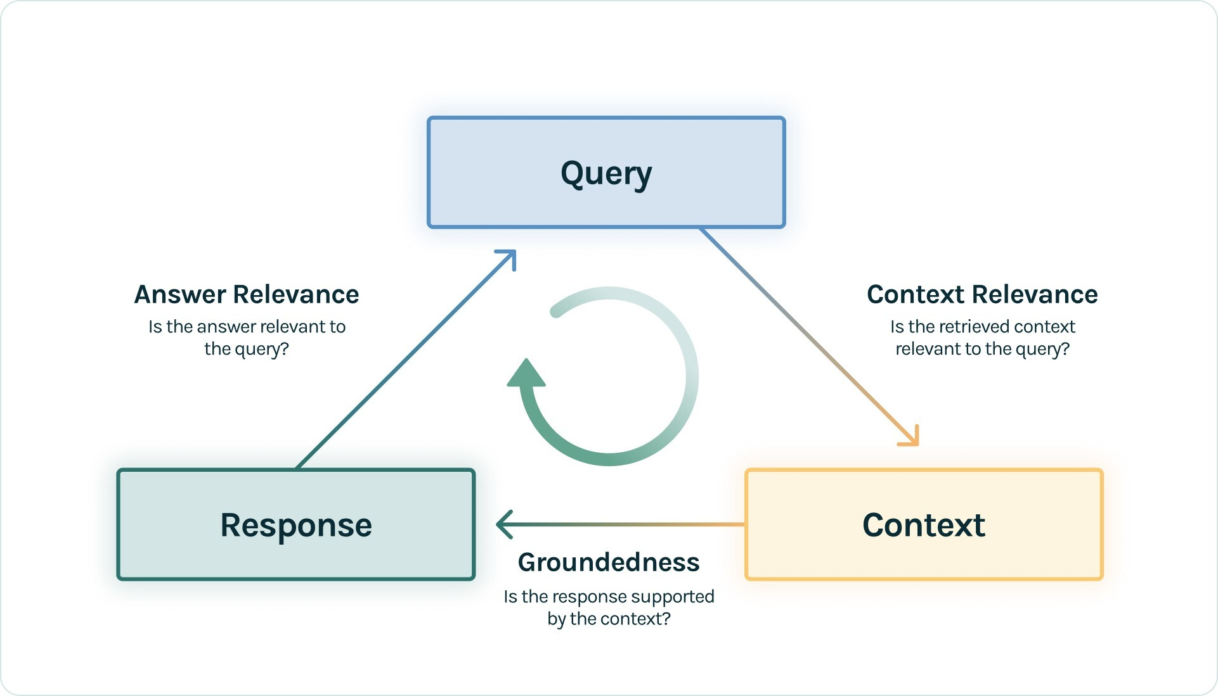
Metrics: TRIAD framework
Context Relevance: This component evaluates the retrieval part of the RAG system. It evaluates how accurately the documents were retrieved from the large dataset. Metrics like precision, recall, MRR, and MAP are used here.
Faithfulness (Groundedness): This component falls under the Response evaluation. It checks if the generated response is factually accurate and grounded in the retrieved documents. Methods such as human evaluation, automated fact-checking tools, and consistency checks are used to assess faithfulness.
Answer Relevance: This is also part of the Response Evaluation. It measures how well the generated response addresses the user's query and provides useful information. Metrics like BLEU, ROUGE, METEOR, and embedding-based evaluations are used.
https://www.trulens.org/trulens_eval/getting_started/core_concepts/rag_triad/

Slide 14
Metrics for RAG
Component | metric | Metric definition
RETRIEVAL | Context precision | Evaluates the ability of the retriever to rank retrieved items in order of relevance to the ground truth answer
 | Context recall | Measures the extent to which the retrieved context aligns with the ground truth answer
GENERATION | Faithfulness | Measures the factual consistency of the generated answer against the retrieved context
 | Answer relevance | Measures how relevant the generated answer is to the given prompt (question + retrieved context)
OVERALL | Answer semantic similarity | Measures the semantic similarity between the generated answer and the ground truth
 | Answer correctness | Measures the accuracy of the generated answer compared to the ground truth

Slide 15
LLM evaluations

Slide 16
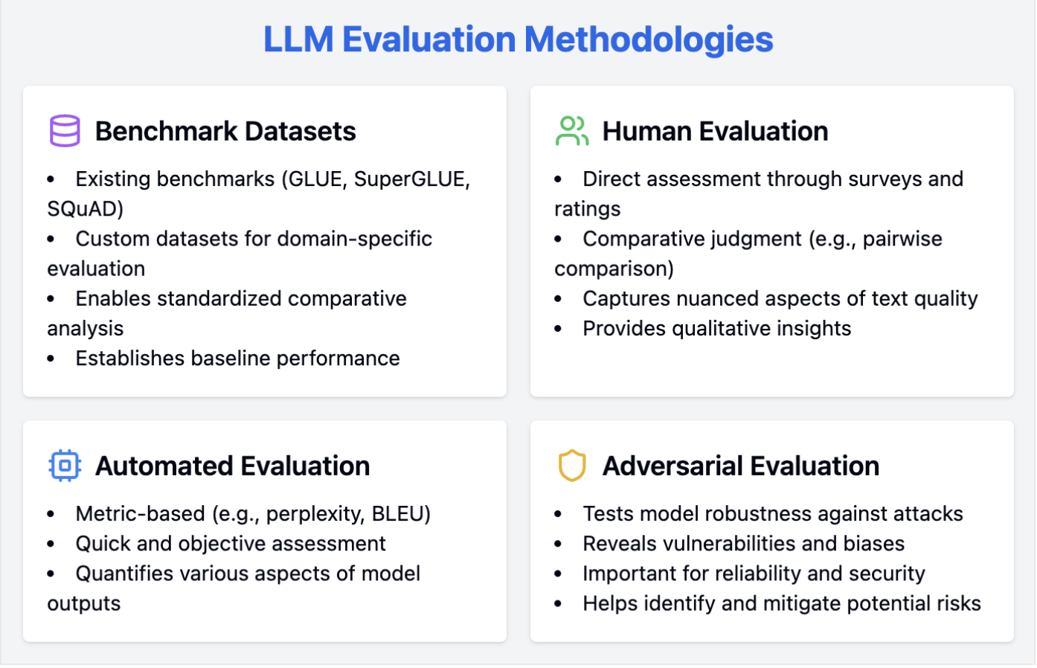
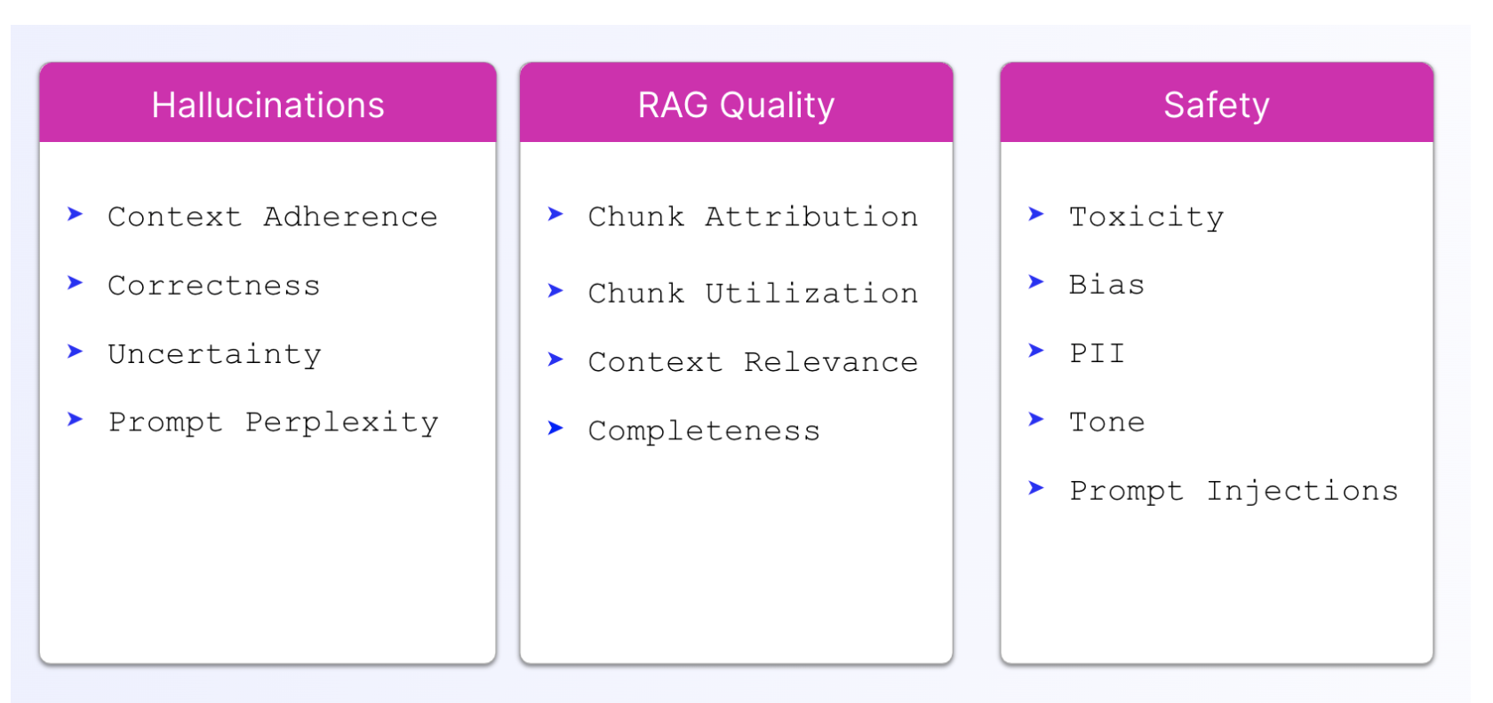
LLM Evaluations
RAG vs. Fine Tuning
Guardrails
Prompt injection
Pii removal when sending to LLM
RAG: multimodal
Opensource vs. proprietary
Regulatory compliance

Slide 17
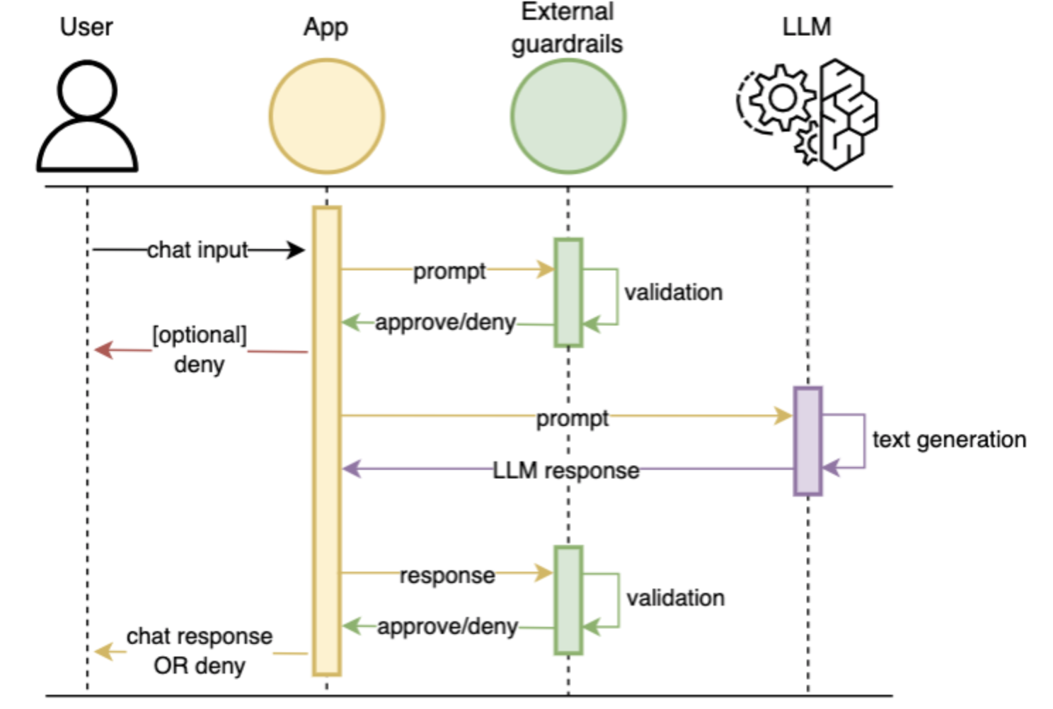
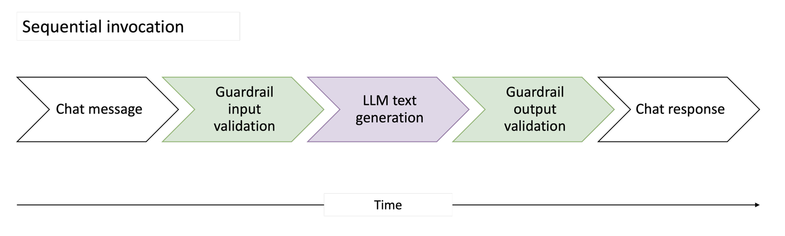
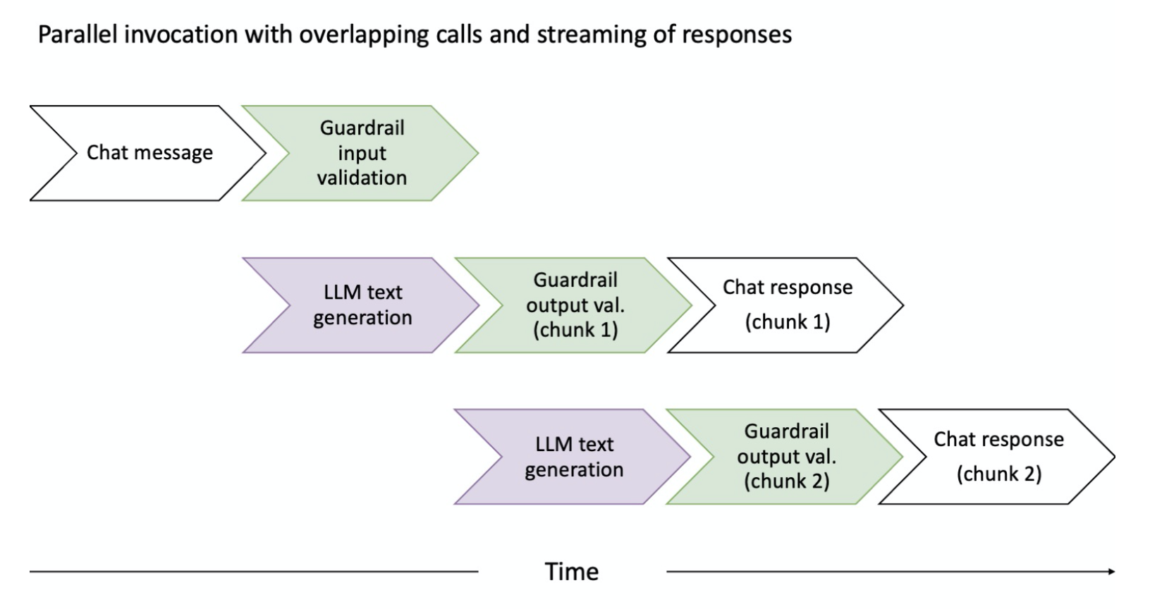
LLM Evaluations: guardrails
Both input and output need to be filtered by Guardrails
To improve latency, evaluation of individual output chunks can be performed

Slide 18
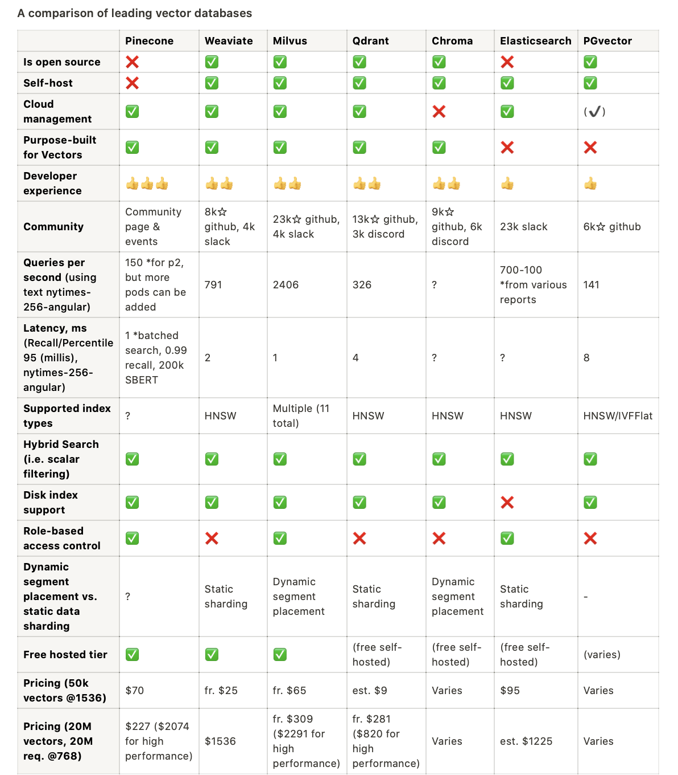
Vector Database Comparison (2023)

Slide 19
Vector Database Comparison (2023)
Is open source: Indicates if the software's source code is freely available to the public, allowing developers to review, modify, and distribute the software.
Self-host: Specifies if the database can be hosted on a user's own infrastructure rather than being dependent on a third-party cloud service.
Cloud management: Offers an interface for database cloud management
Purpose-built for Vectors: This means the database was specifically designed with vector storage and retrieval in mind, rather than being a general database with added vector capabilities.
Developer experience: Evaluates how user-friendly and intuitive it is for developers to work with the database, considering aspects like documentation, SDKs, and API design.
Community: Assesses the size and activity of the developer community around the database. A strong community often indicates good support, contributions, and the potential for continued development.
Queries per second: How many queries the database can handle per second using a specific dataset for benchmarking (in this case, the nytimes-256-angular dataset)
Latency: the delay (in milliseconds) between initiating a request and receiving a response. 95% of query latencies fall under the specified time for the nytimes-256-angular dataset.
Supported index types: Refers to the various indexing techniques the database supports, which can influence search speed and accuracy. Some vector databases may support multiple indexing types like HNSW, IVF, and more.
Hybrid Search: Determines if the database allows for combining traditional (scalar) queries with vector queries. This can be crucial for applications that need to filter results based on non-vector criteria.
Disk index support: Indicates if the database supports storing indexes on disk. This is essential for handling large datasets that cannot fit into memory.
Role-based access control: Checks if the database has security mechanisms that allow permissions to be granted to specific roles or users, enhancing data security.
Dynamic segment placement vs. static data sharding: Refers to how the database manages data distribution and scaling. Dynamic segment placement allows for more flexible data distribution based on real-time needs, while static data sharding divides data into predetermined segments.
Free hosted tier: Specifies if the database provider offers a free cloud-hosted version, allowing users to test or use the database without initial investment.
Pricing (50k vectors @1536) and Pricing (20M vectors, 20M req. @768): Provides information on the cost associated with storing and querying specific amounts of data, giving an insight into the database's cost-effectiveness for both small and large-scale use cases.

